Slide 1


Grade 9
1st Quarter
Lesson 1

Slide 2


Notes:
Prayer

Slide 3
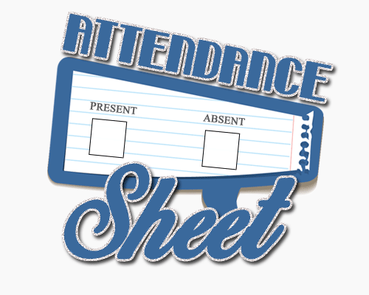

Notes:
Checking of attendance

Slide 4


Slide 5


Slide 6


Notes:
Checking of attendance

Slide 7

Let us have a short review of the things you learned from last school year.

Slide 8

What is the latest version of HTML as of 2022?
1
Answer: HTML5

Slide 9

This refers to the declaration that specifies the HTML version being used and helps browsers render the web age correctly.
2
Answer: <!DOCTYPE html>

Slide 10

Give the 2 main parts of an HTML document?
3
Answers: 1. <head>
2. <body>

Slide 11

The tag that specifies the source (URL) of the script or image.
4
Answer: src

Slide 12

The attribute that provides an alternative text for an image, which will be displayed if the image fails to load.
5
Answer: alt

Slide 13
This tag is used to create hyperlinks, allowing users to navigate between different web pages.
6
Answer: <a>

Slide 14
What tag is used together with <ol> or <ul>?
7
Answer: <li>

Slide 15
What is the attribute used that specifies the URL of the page the link goes to?
8
Answer: href

Slide 16
This tag is used to contains the metadata about the HTML document.
9
Answer: <head>

Slide 17
This tag is used to contains the content of the HTML document.
10
Answer: <body>

Slide 18

What
is
XHTML?

Slide 19
XHTML is an acronym for eXtensible HyperText Markup Language.
The ”x” came from XML or eXtensible Mark-up Language.
Though different from HTML, XHTML also uses the filename extension .html
The content of the actual coding might change because of XHTML conventions but it still holds the same filename extension.

Slide 20

What is the difference between XHTML and HTML?

Slide 21
XHTML is stricter and cleaner version of HTML.
Aimed to replace HTML.
All new Web browsers support XHTML, because there came to a point that a huge amount of web pages have been written in the wrong syntax. Since web browsers still force to interpret HTML the way they could, sometimes the wrong syntax could still display a logically correct output.

Slide 22
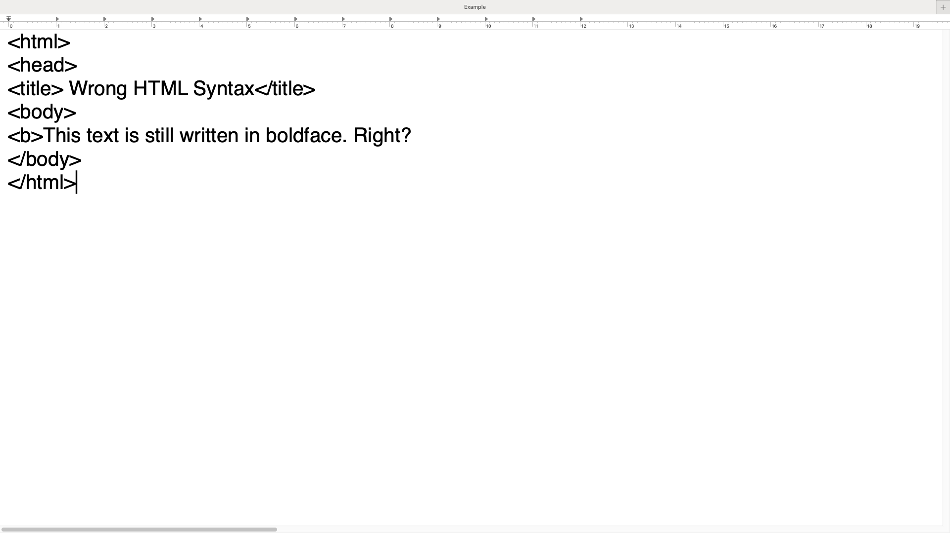

Identify the error/s in this HTML document
Notes:
Answer is yes.

Slide 23
Will the given example produce the correct output when opened in a browser?

Slide 24

Time to code!
Using your gadgets, copy the code and save it as an html document, then open it in a browser.
What is the output?

Slide 25
Why XHTML?
The current market is composed of many different browser technologies. Some of them run on computers, some on mobile phones, even some on other hand-held devices. Not all of them have the capability to successfully interpret wrong HTML syntax. So, XHTML was developed to cater to the fast-paced growth of technology.

Slide 26
Proper Nesting
Proper nesting of elements has been exemplified and XHTML elements must be properly nested. Proper nesting of elements would mean that, for example, if you were to make a piece of text appear in boldface and italics using <b></b> and <i></i> respectively.
You would need to close last the first tag you opened.
Identify the error in this statement:
<b><i>This text will appear in boldface and in italics</b></i>
Ans: <b><i>This text will appear in boldface and in italics</i></b>
Notes:
Ask for a student to write the correct statement. The correct statement is <b><i>This text will appear in boldface and in italics</i></b>

Slide 27
Proper Tag Closing
Recall the container tags. Container tags have start and end tags; and end tags are defined by a slash. End tags are used to basically close the tag. XHTML requires proper closing of tags.
Identify the error in this statement:
<p>XHTML requires proper closing of tags.
Ans. <p>XHTML requires proper closing of tags. </p>
Notes:
Ask for a student to write the correct statement. The correct statement is <p>XHTML requires proper closing of tags.</p>

Slide 28
Proper Tag Closing
Recall empty tags. Empty tags are stand-alone type of tags, they don’t require an end tag. But since XHTML requires proper closing, things have changed a bit for empty tags. A slash defines end tags, thus, it simplifies closing. In the same sense, a slash will be used in empty tags for it to be properly closed. A slash is placed before the end of an angle bracket of a tag.
Identify the error in this statement:
<img src=“violetFlower.jpg”><hr><br>
In XHTML, even empty tags have to be closed following given format.
Ans. <img src=“violetFlower.jpg”/><hr/><br/>
Notes:
Ask for a student to write the correct statement. The correct statement is <img src=“violetFlower.jpg”/><hr/><br/>

Slide 29
Elements in Lowercase Characters
XHTML elements MUST be written in lowercase characters.
Identify the error in this statement:
<P>Elements should be written in lowercase.</P>
Ans. <p>Elements should be written in lowercase.</p>
Notes:
Ask for a student to write the correct statement. The correct statement is <p>Elements should be written in lowercase.</p>

Slide 30
One Root Element
All XHTML elements MUST be nested within one root element which is <html></html>. Therefore, the basic structure for the whole document is:
<html>
<head>
<title>One Root</title>
</head>
<body>
<!- - body part goes here - ->
</body>
</html>

Slide 31
Attributes in Lowercase Characters
All XHTML elements MUST be written in lowercase characters same as with the attributes.
Identify the error/s in the statement:
<img SRC=“violetFlower.jpg” />
Ans. <img src=“violetFlower.jpg” />
Notes:
Ask for a student to write the correct statement. The correct statement is <img src=“violetFlower.jpg” />

Slide 32
Quoted Values
Values of attributes are described as “usually enclosed in single and double quotes”. XHTML requires values to be quoted nevertheless.
Identify the error/s in the statement:
<hr width=200 />
Ans. <hr width=“200” />
Notes:
Ask for a student to write the correct statement. The correct statement is <hr width=”200” />

Slide 33
Forbidden Attribute Minimization
In HTML, there are attributes that don’t need values; just like the noshade attribute of horizontal rules, noresize attributes of frames and checked attribute of checkboxes and radio buttons. But XHTML forbids such (also known as attribute minimization). In order to fix this, XHTML requires that type of attributes to have a value equal to its attribute name.
Identify the error/s in the statement:
<hr noshade />
Ans. <hr noshade=“noshade” />
Notes:
Ask for a student to write the correct statement. The correct statement is <hr noshade=“noshade” />

Slide 34
Image Alternate Texts
Remember the alt attribute in images? It is used to display an alternate text of the text that appears when the mouse hovers over the image and when the image cannot be displayed. In XHTML, image alternative texts are now mandatory. In cases where the image is only for decoration purposes, you can provide it a null value by using a space.
Ex. <img src=“violetFlower.jpg” alt=“ “ />
Identify the error/s in the statement:
<img src=“moltres.jpg”>
Ans. <img src=“moltres.jpg” alt=“a picture of moltres”/>
Notes:
Ask for a student to write the correct statement. The correct statement is <img src=“moltress.jpg alt=“a picture of moltres” />

Slide 35
Amperstands in URLs
Amperstands are usually used in URLs to carry variables. In XHTML, it is required to escape this using the special character entity (&amp). On Web browser screens, it is of course displayed as amperstands.
Identify the error/s in the statement:
<a href=“dataLibrary.php?page=12&style=green”>link</a>
Ans.
<a href=“dataLibrary.php?page=12&ampstyle=green”>link</a>
Notes:
Ask for a student to write the correct statement. The correct statement is <a href=“dataLibrary.php?page=12&amp;style=green”>link</a>

Slide 36
Contents within Block-Level Elements
In XHTML Strict, you cannot just put content directly inside <body></body>. Contents must be placed within <p></p>, <ol></ol>, etc. (also known as block-level elements). Another good reason to put <span></span> and <div></div> into practice.
Identify the error/s in the statement:
<body> Put chunk of text here.</body>
Ans. <body> <div>Put chunk of text here.</div></body>
Notes:
Ask for a student to write the correct statement. The correct statement is <body> <div>Put chunk of text here.</div></body>.

Slide 37



Slide 38

How can you apply the lesson in your activities as a student? (Practical/actual application)

Slide 39



Slide 40

Assignment:
1. Choose a FREE web
hosting site where
you can publish
your web page.
Learn how to publish
a web page.

Slide 41
Graded Activity #1
Open your browser and type the link (https://forms.office.com/r/3pNZNvJ8aQ) in the address bar.
Read and follow the instructions
carefully.
3. You are given 5 minutes to answer.
Notes:
Ask for a student to write the correct statement. The correct statement is <body> <div>Put chunk of text here.</div></body>.

Slide 42


